Slide 1
Efficient LabVIEW FPGA Development and Testing
Kalyanramu Vemishetty

Slide 2
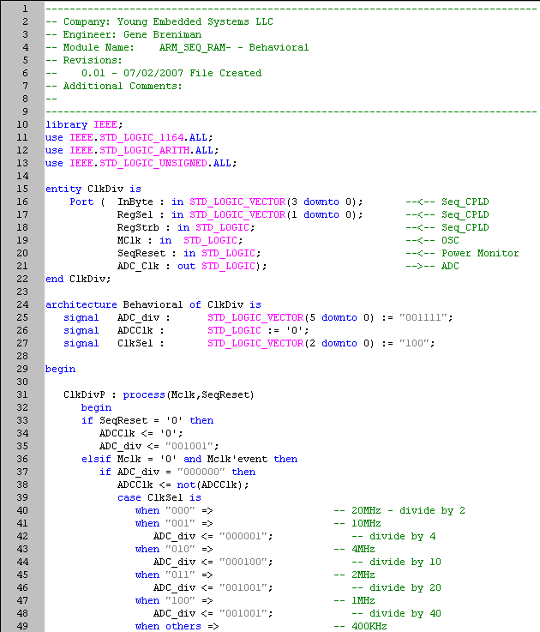
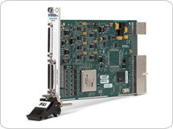
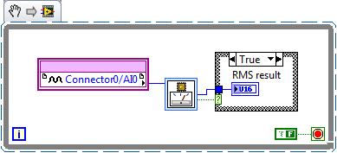
LabVIEW FPGA
Reconfigurable I/O
Custom hardware algorithms

Slide 3
LV FPGA Development Process
Requirements
Design
Implement
Test
Deploy

Slide 4
Increasing Efficiency
Implement
Compile
Test
actual output
time to create application
Efficiency =
=
standard output
average time to create application

Slide 5
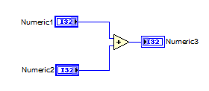
Increasing Efficiency
Implement
15 sec
Compile
544 sec
Test
65 sec
actual output
time to create application
Efficiency =
=
standard output
average time to create application

Slide 6
Reduce Compile Time
Buy a faster compilation machine
Improve the compiler (Xilinx, NI)
Experience
Precompile testing

Slide 7
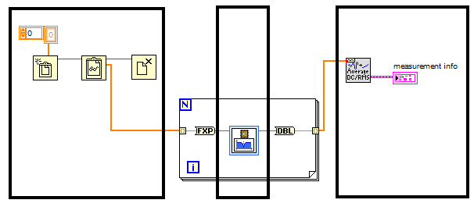
Precompile Testing – Simulation on Windows
Stimulus
FPGA code
Response

Slide 8
Precompile Testing – On Windows
Good for inline algorithms
-
No timing
I/O does not work
Allows Windows VIs
Partial Simulation
Quick
+

Slide 9
Precompile Testing – Development Computer with Simulated I/O

Slide 10
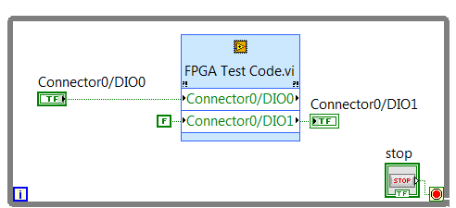
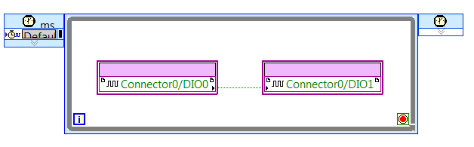
Simulating FPGA Code
Host Code providing stimulus
And response
FPGA Code for simulation

Slide 11
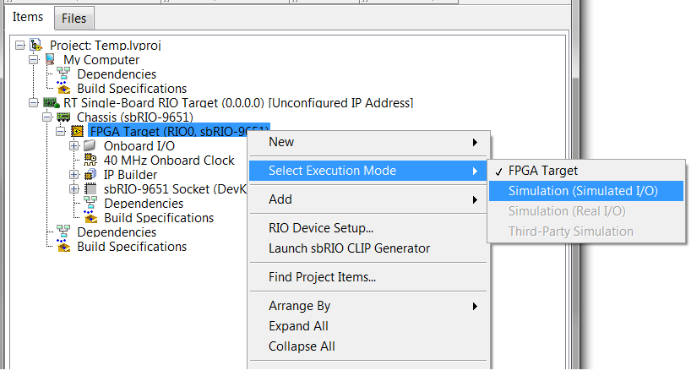
Step 1: Set Simulation Mode

Slide 12
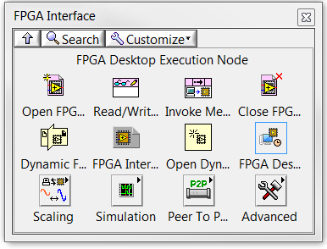
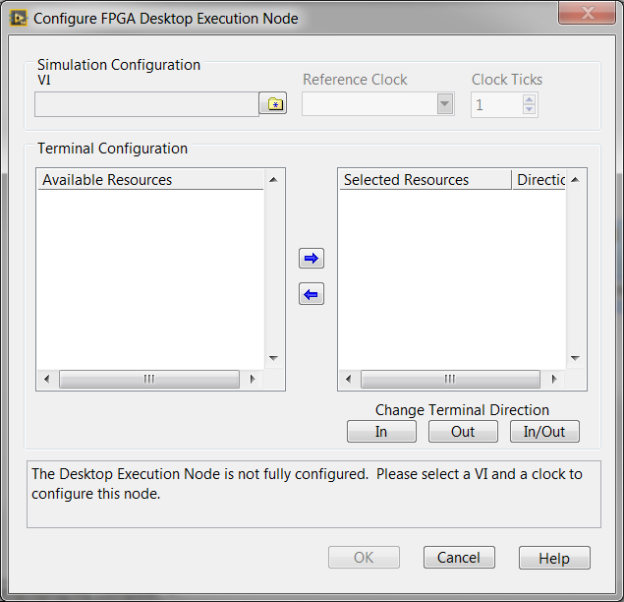
Step 2: Configure Desktop Execution Node

Slide 13
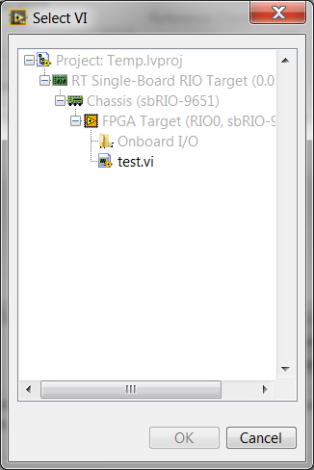
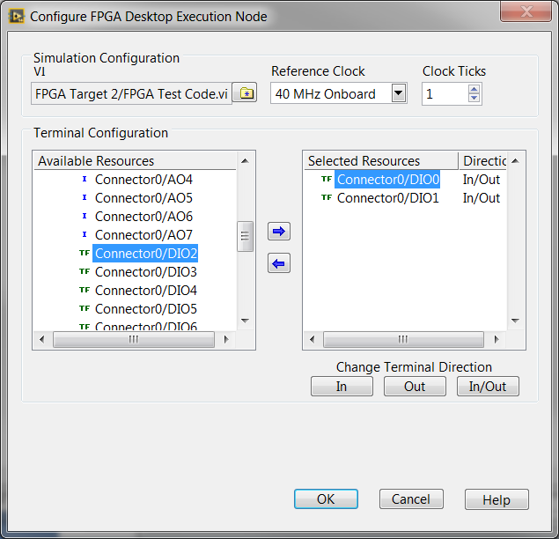
Step3 :Select VI to simulate

Slide 14
Simulating FPGA Code
Host Code providing stimulus
And response
FPGA Code for simulation

Slide 15
Debugging Simulation Code

Slide 16
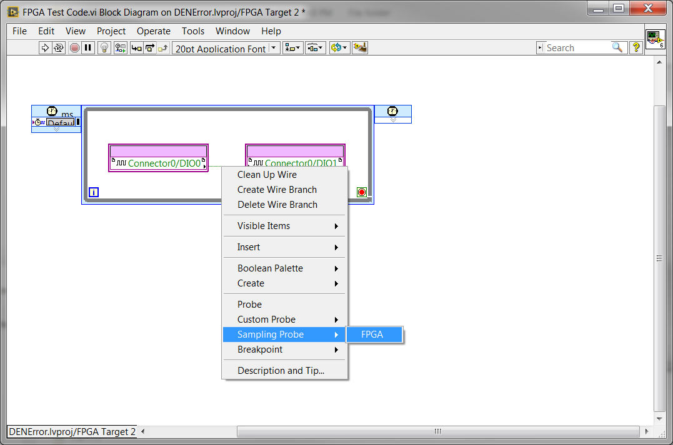
Use Waveform Probes

Slide 17
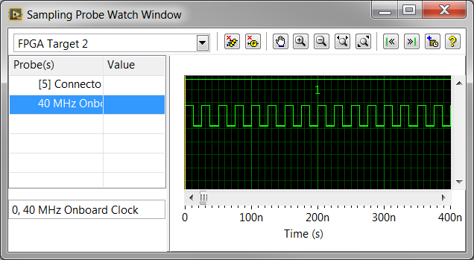
Waveform Probes

Slide 18
Automated Test Suite

Slide 19
Unit Test Framework
Create Unit Test for VI using Desktop Exec Node
Run the Unit Test
Place the Unit Tests into folder
Run all for code change
Get code coverage
Notes:
Unit Test Framework is great because if you make a change to the code…you can understand by how much it breaks current code coverage

Slide 20
Simulating FPGA Code
Host Code providing stimulus
And response
FPGA Code for simulation

Slide 21
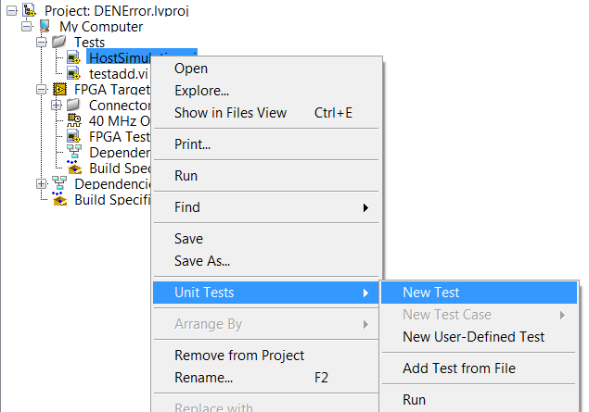
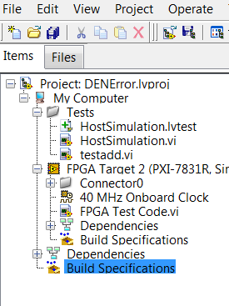
Creating Unit Test

Slide 22
Demo
Create Unit Test for Add Numbers
Add “New Test Case” using Front Panel
Add Test Vectors from File
Notes:
Trick:
Open Front Panel
Enter Stimulus
Run the VI
Right Click on VI in the project >> Unit Tests >> Add New Test Case

Slide 23
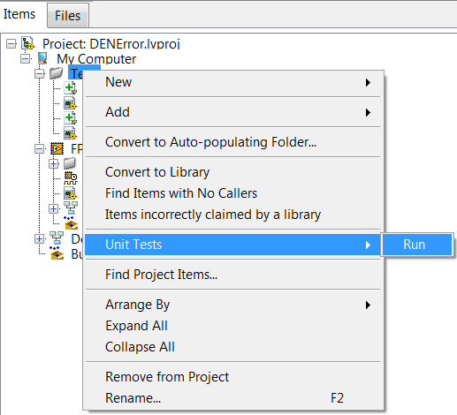
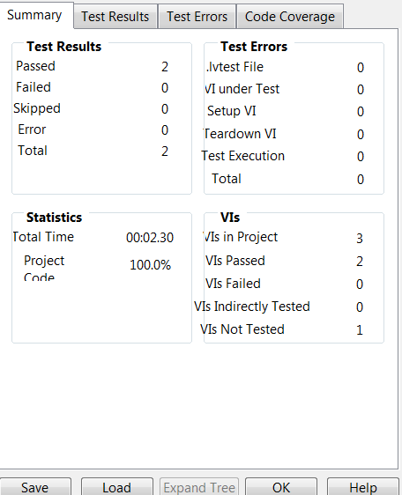
Automate Tests
Code Coverage Report
Notes:
Place all Unit Tests in one folder
To get code coverage
Right click on the folder >> Unit Tests >> Run

Slide 24
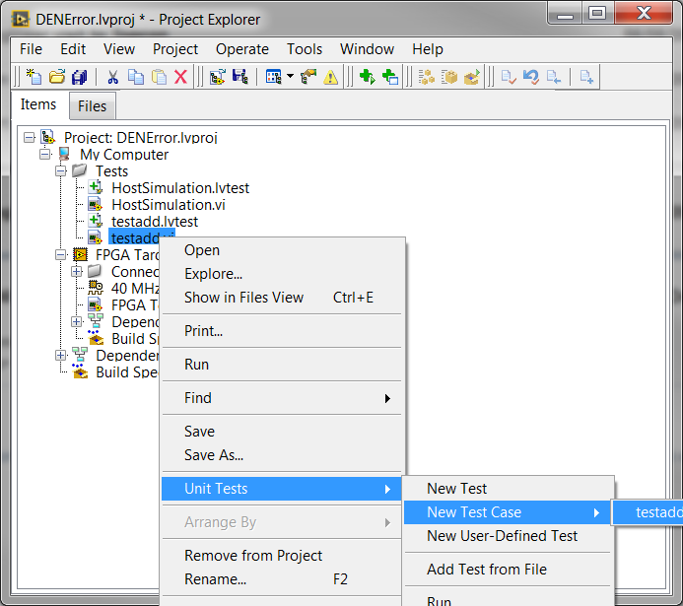
Trick

Slide 25
Source Code Control

Slide 26
Links
Tutorial on FPGA Debugging
http://www.ni.com/tutorial/51862/en/
Tutorial on Unit Test
https://www.youtube.com/watch?v=TCaqxXIODnc
Linux Compile Farm
http://www.ni.com/tutorial/14039/en/
Tutorial on Source Code Control

Slide 27
Tips to save resources
Make subVI’s re-entrant if loops are slow
Use registers insteadd of local variables

Slide 28

Questions

